Slide 1
Programming Machine Learning Applications
Lecture Seven: Clustering and PCA
Dr. Aleksandar Velkoski

Slide 2
Review of Lecture Six
Regression
Gradient Descent
Discuss Code

Slide 3
Lecture Seven
Hyperparameter Tuning
Clustering
Principal Component Analysis

Slide 4
Hyperparameter Tuning

Slide 5
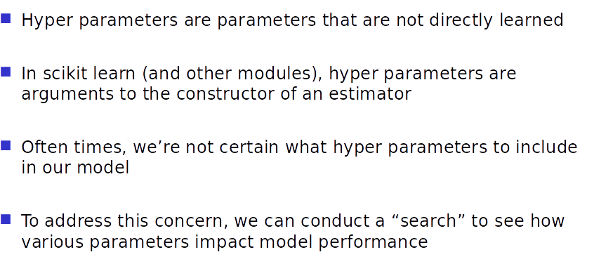
Introduction to Hyperparameter Tuning

Slide 6
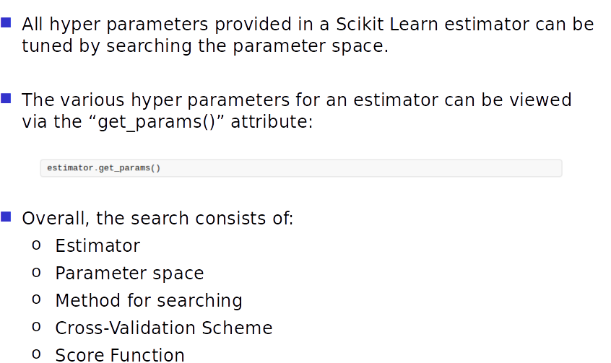
Introduction to Hyperparameter Tuning

Slide 7
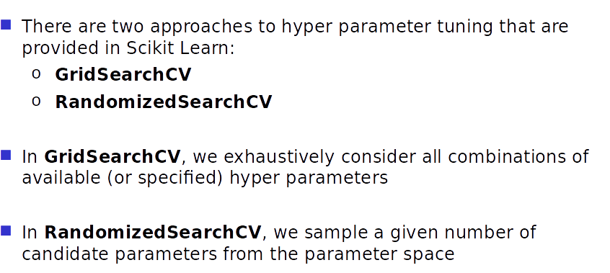
Hyperparameter Tuning Approaches

Slide 8
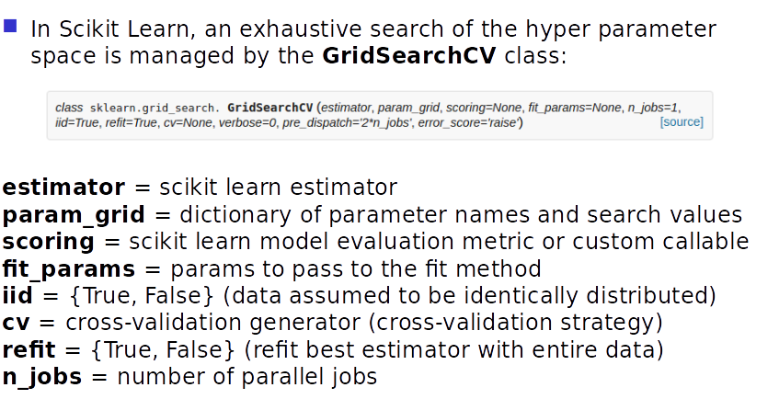
Hyperparameter Approaches: GridSearchCV

Slide 9
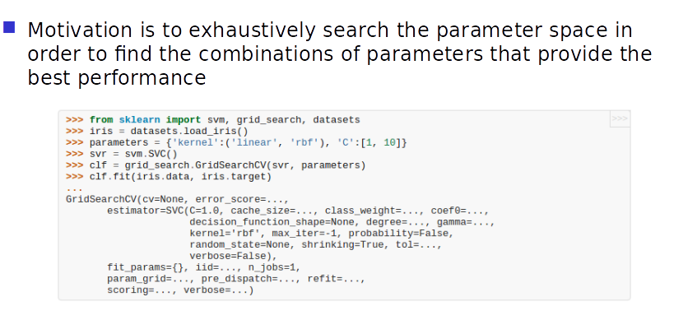
Hyperparameter Approaches: GridSearchCV

Slide 10
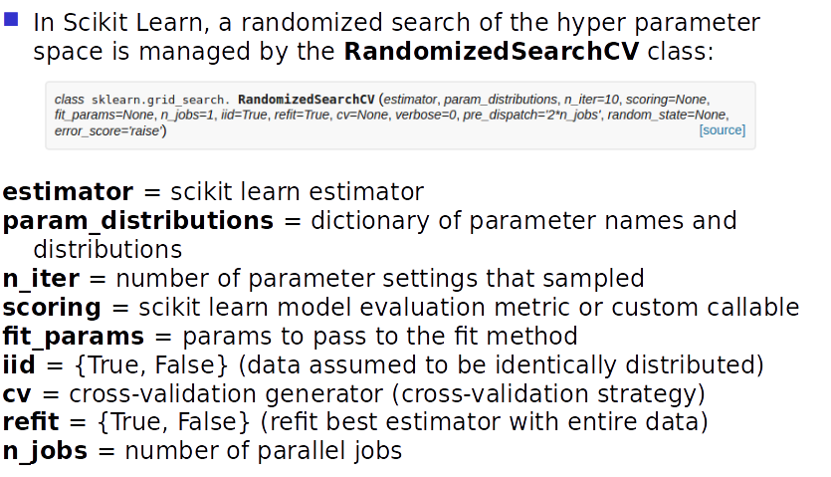
Hyperparameter Approaches: RandomizedSearchCV

Slide 11
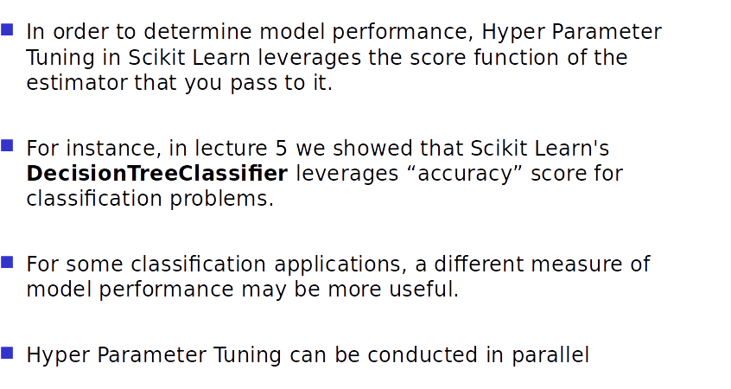
Performance

Slide 12
Clustering

Slide 13
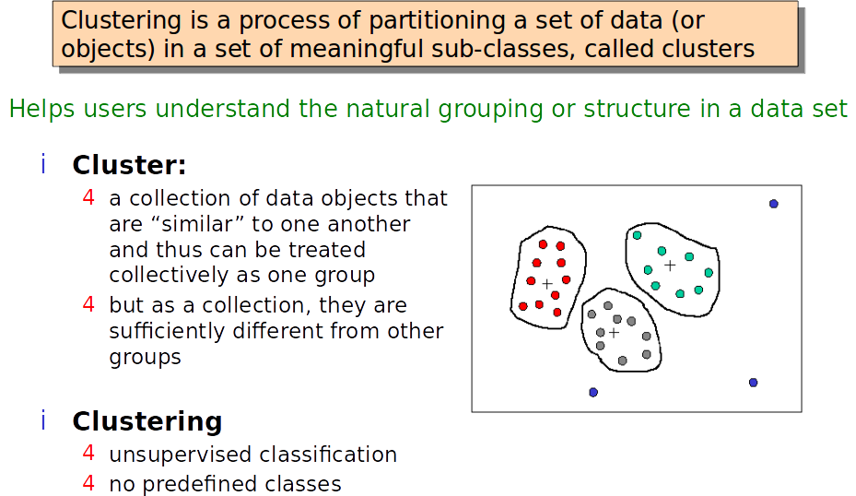
What is Clustering?

Slide 14
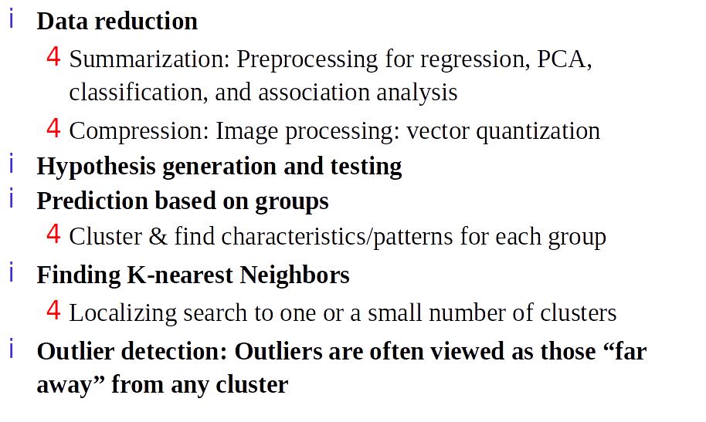
Applications of Cluster Analysis

Slide 15
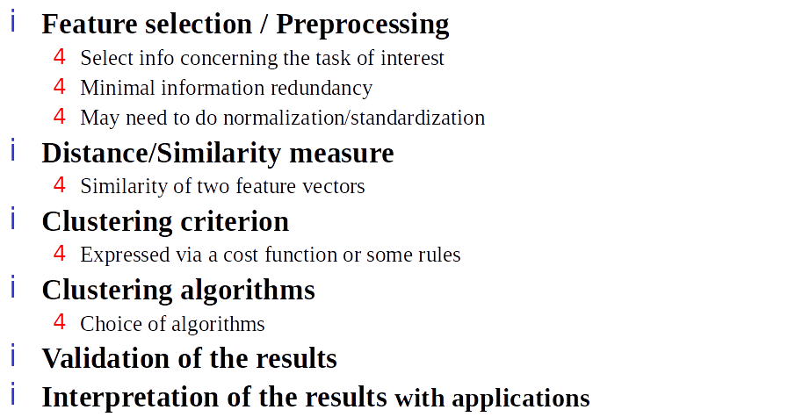
Steps of a Clustering Task

Slide 16
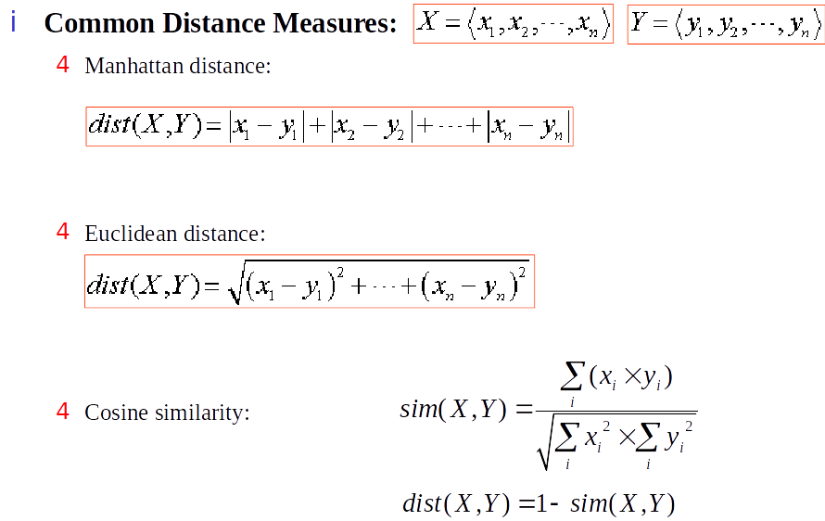
Common Distance Measures

Slide 17
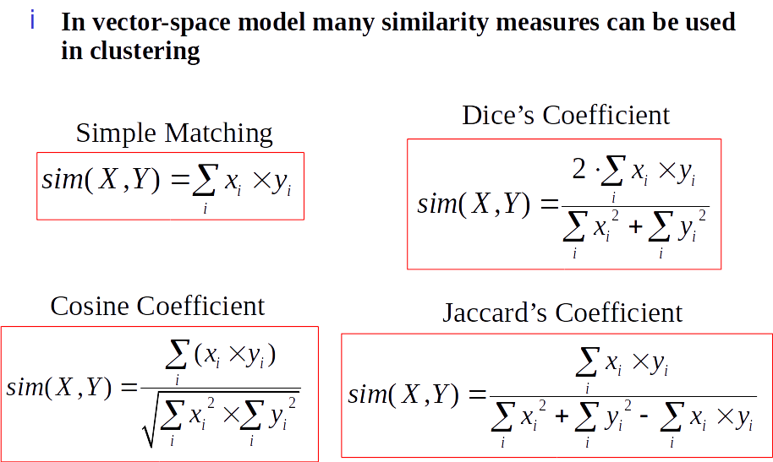
More Distance Measures

Slide 18
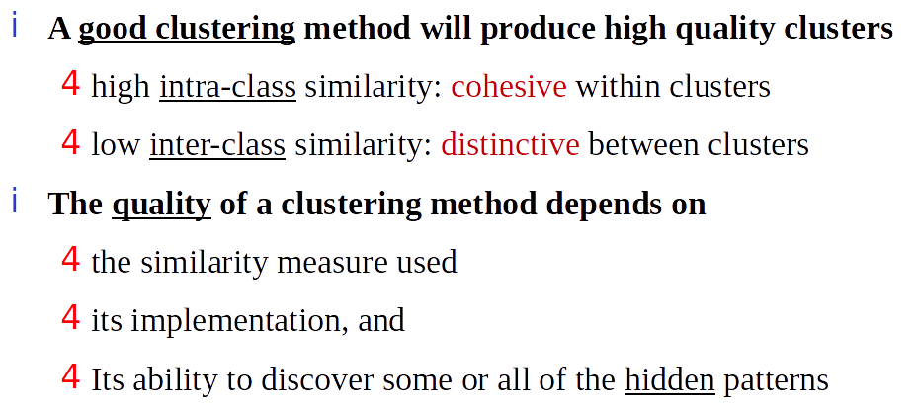
What is a Good Cluster?

Slide 19
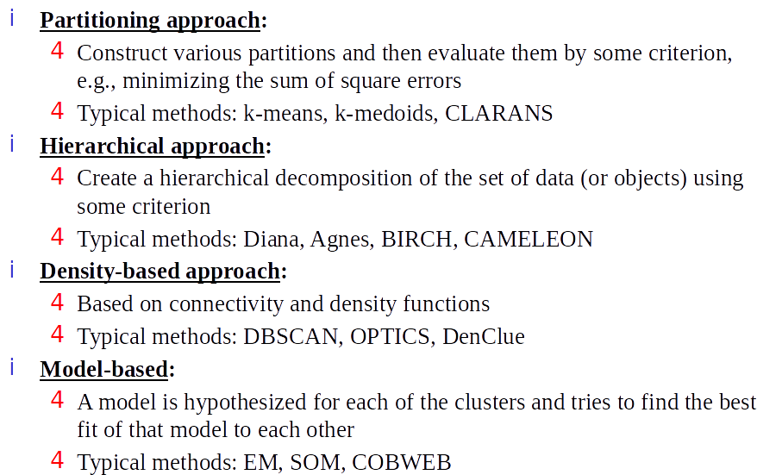
Major Clustering Approaches

Slide 20
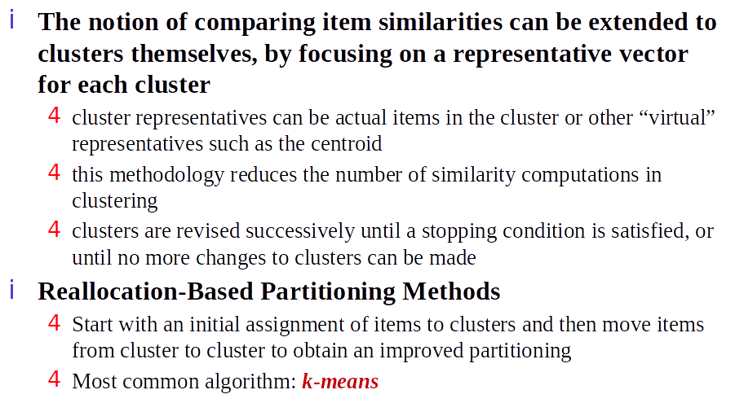
Partitioning Approaches

Slide 21
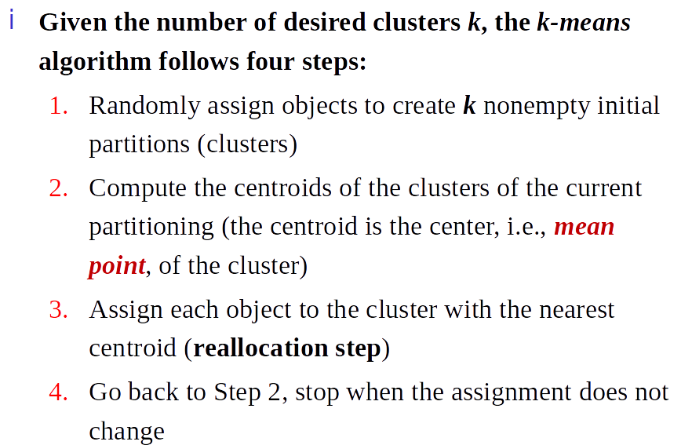
k-Means Clustering Method

Slide 22
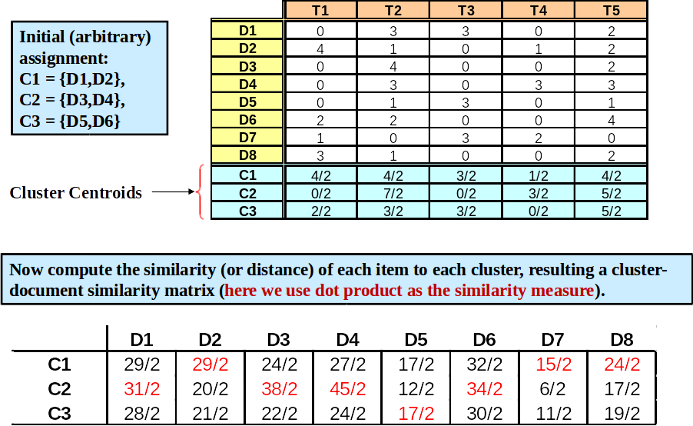
k-Means Document Clustering Example

Slide 23
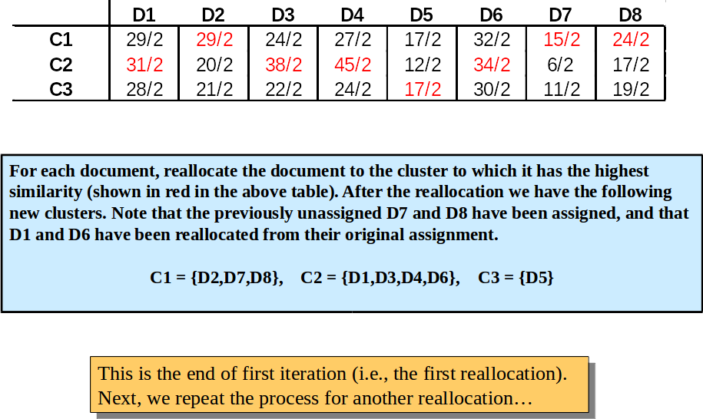
k-Means Document Clustering Example

Slide 24
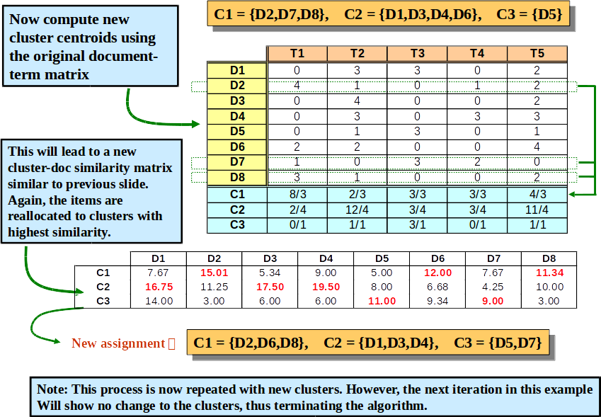
k-Means Document Clustering Example

Slide 25
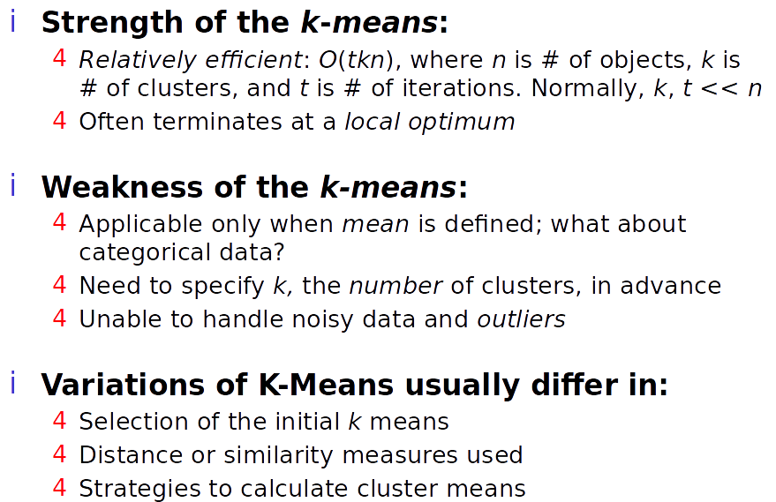
k-Means Algorithm

Slide 26
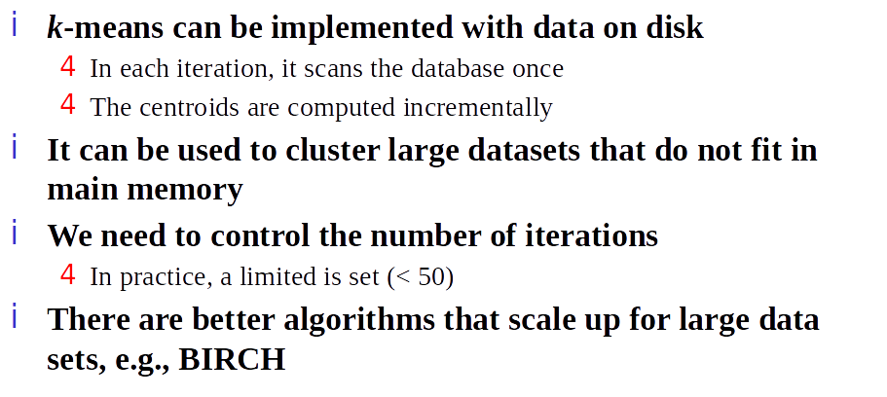
A Disk Version of k-Means

Slide 27
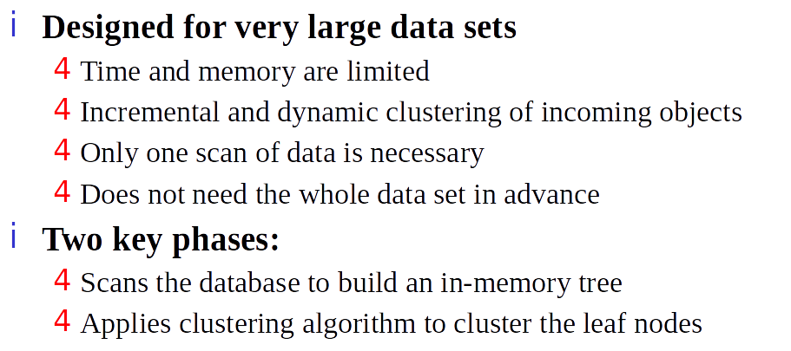
BIRCH

Slide 28
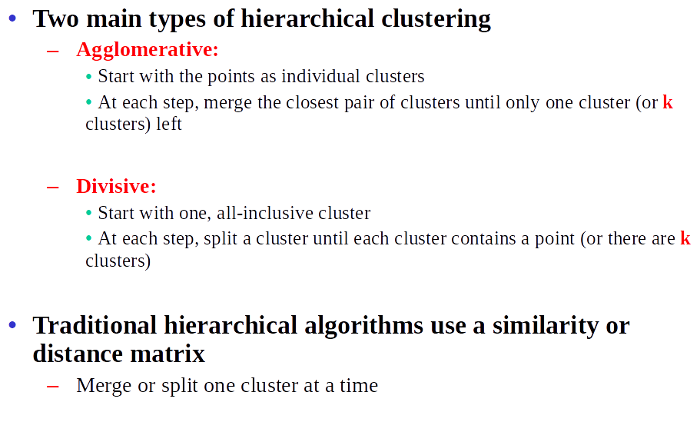
Hierarchical Clustering Algorithms

Slide 29
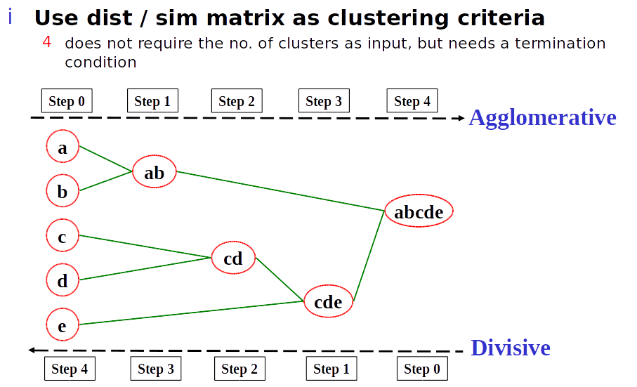
Hierarchical Clustering Algorithms

Slide 30
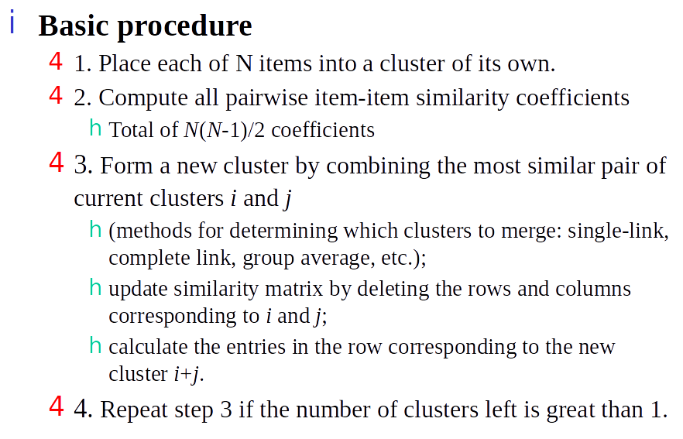
Hierarchical Agglomerative Clustering

Slide 31
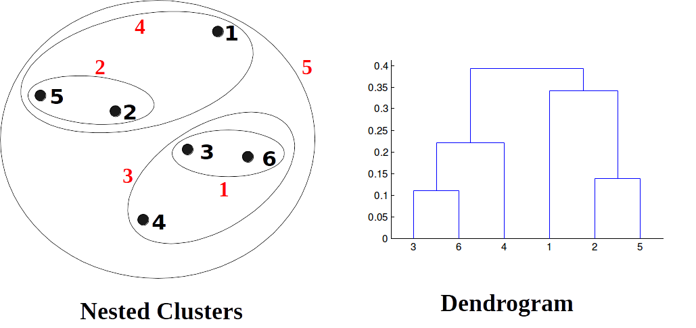
Hierarchical Agglomerative Clustering

Slide 32
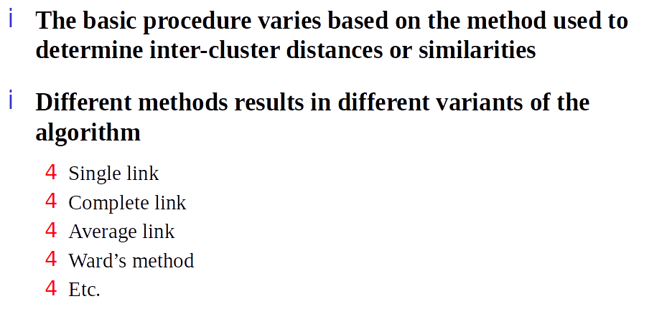
Distance Between Two Clusters

Slide 33
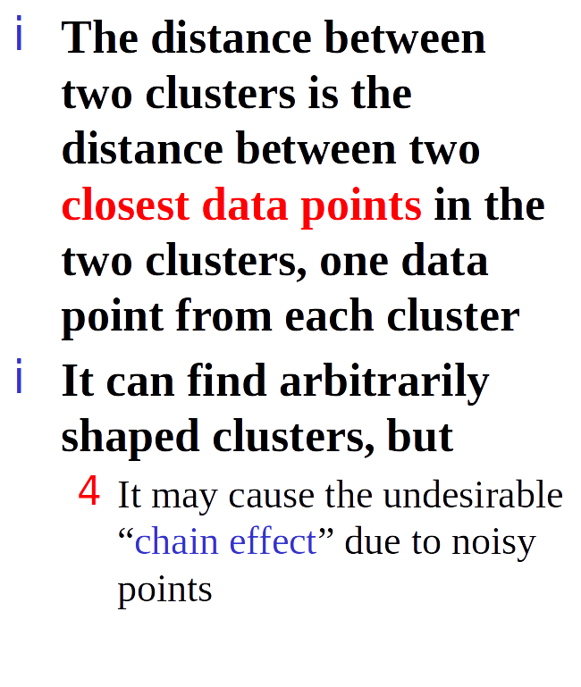
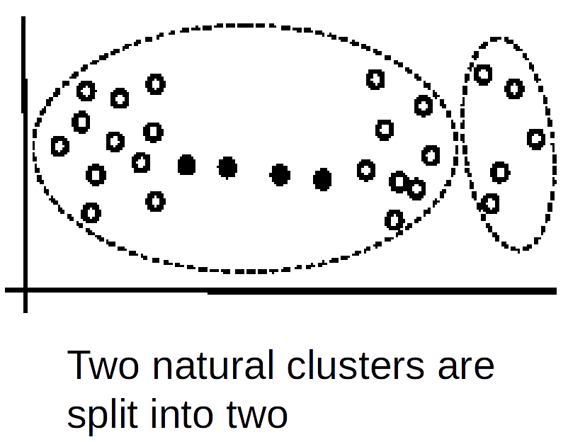
Single Link Method

Slide 34
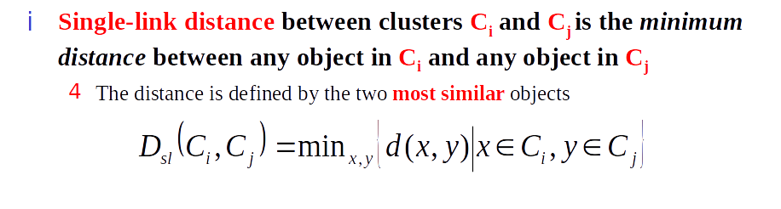
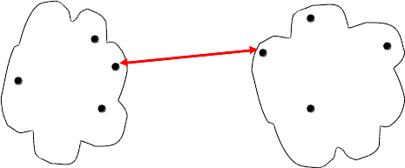
Single Link Method: Distance

Slide 35
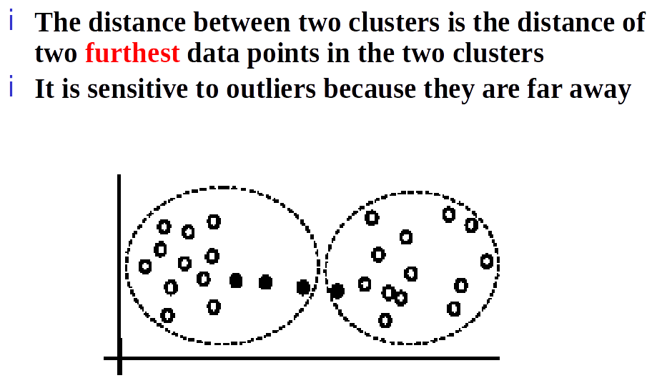
Complete Link Method

Slide 36
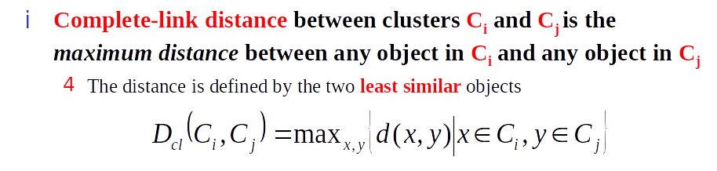
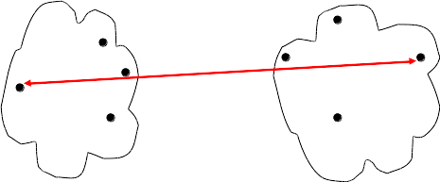
Complete Link Method: Distance

Slide 37
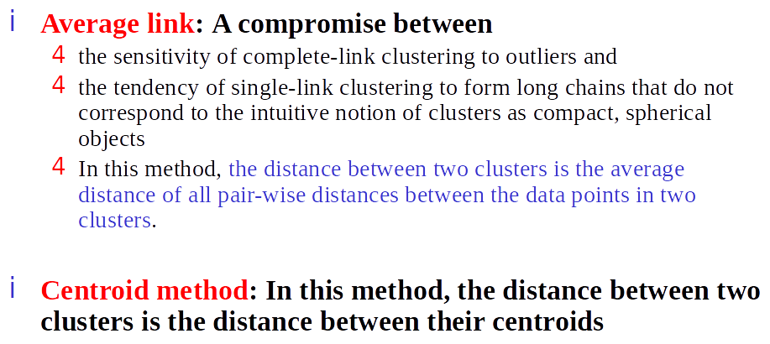
Average Link and Centroid Method

Slide 38
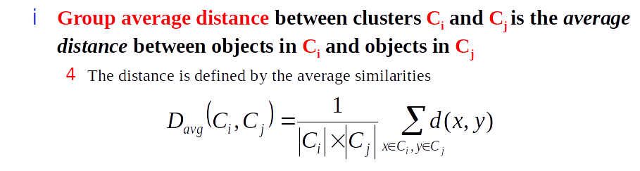
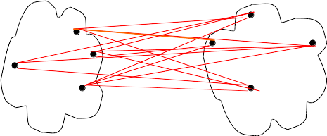
Average Link and Centroid Method

Slide 39
Principal Component Analysis

Slide 40
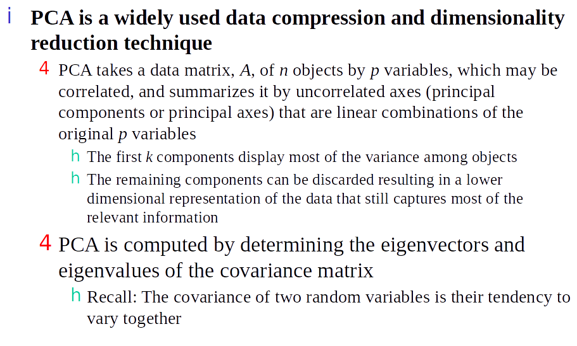
What is PCA?

Slide 41
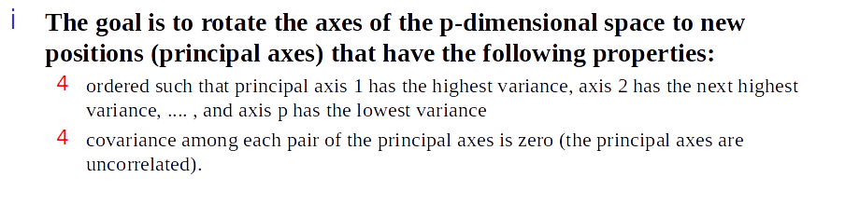
Geometric Interpretation of PCA

Slide 42
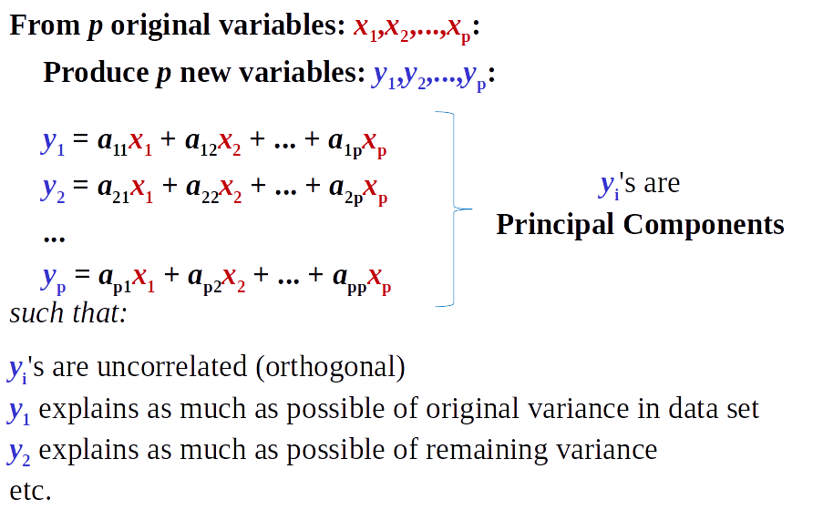
Coordinate Transformation

Slide 43
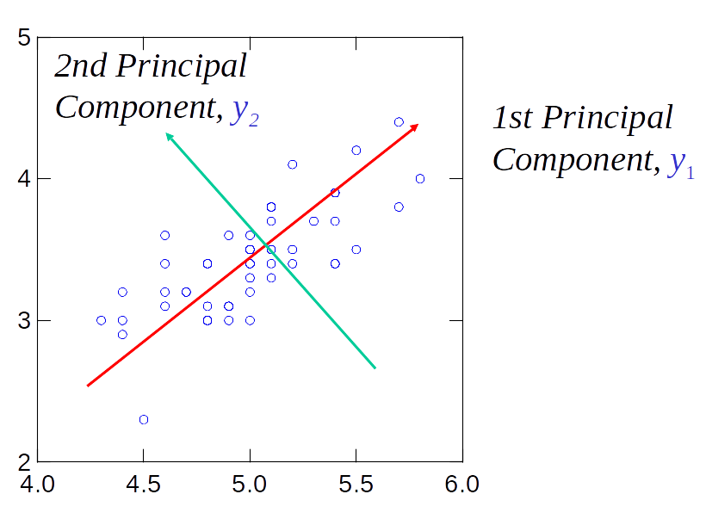
Principal Components

Slide 44
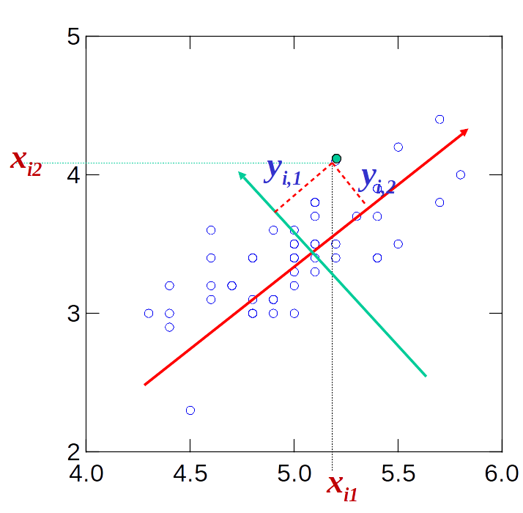
Principal Component Scores

Slide 45
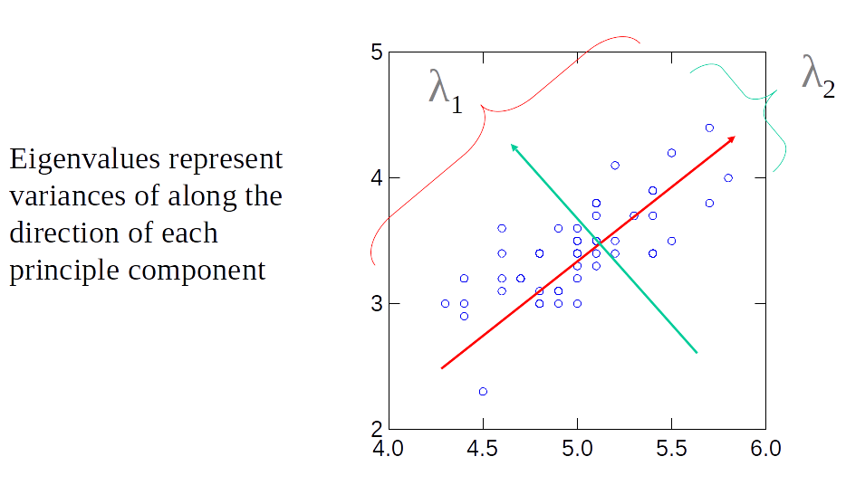
Principal Component Eigenvalues

Slide 46
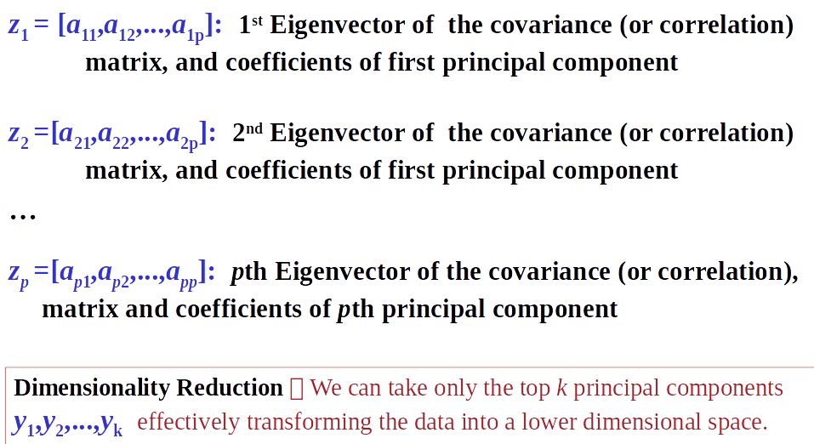
Principal Component Eigenvalues

Slide 47
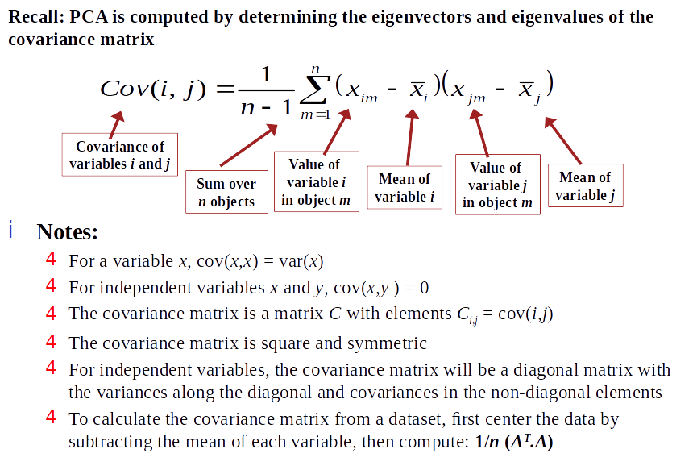
Covariance Matrix

Slide 48
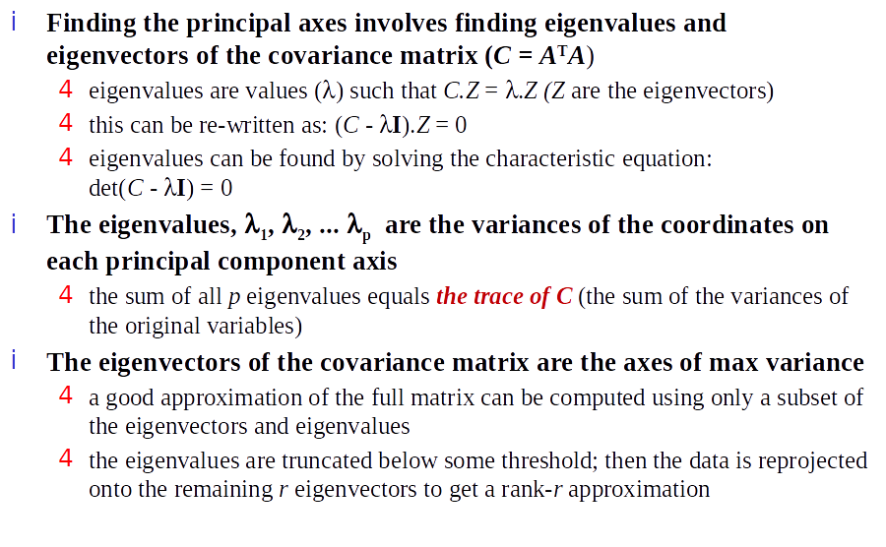
Eigenvalues and Eigenvectors

Slide 49
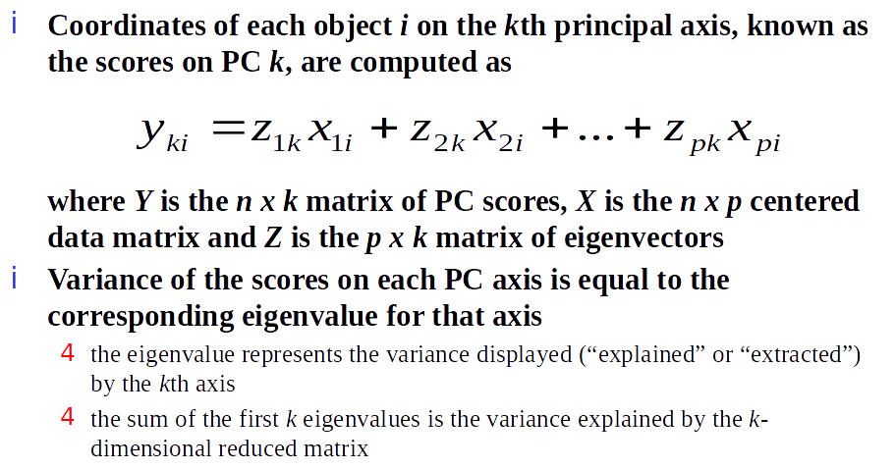
Reduced Dimension Space

Slide 50
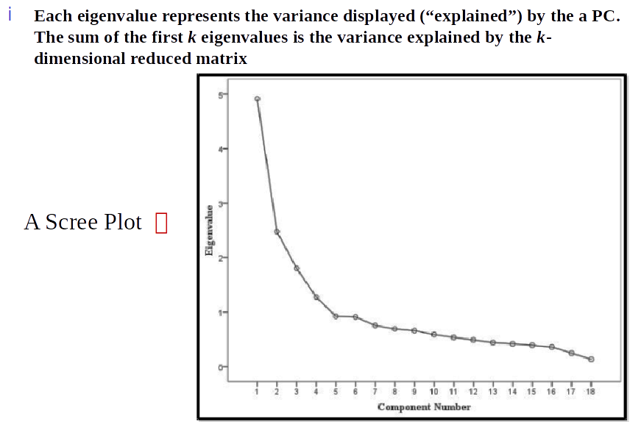
Reduced Dimension Space

Slide 51
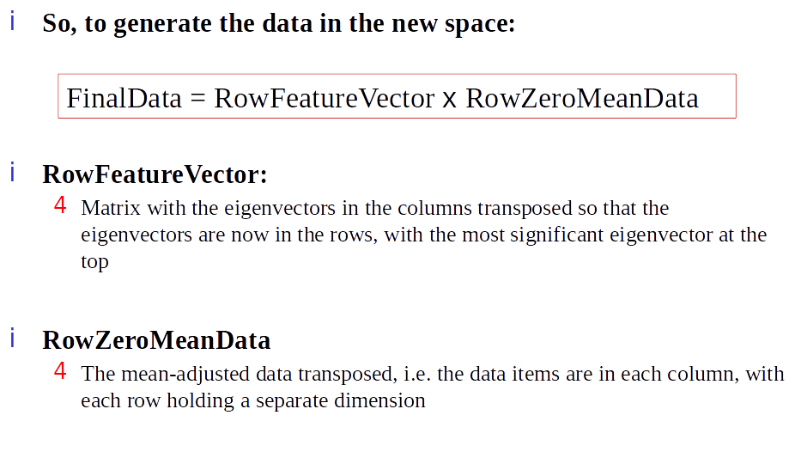
Reduced Dimension Space

Slide 52
Code

Slide 53
Questions
Wrapping-up the Lecture

Slide 54
Why is getting trapped in a local minima a problem in Gradient Descent?

Slide 55
What is a scree plot and why does it matter?

